Slide 1


<Sandip Munda>
<20th November 2023>

Slide 2

Outline
Executive Summary
Introduction
Methodology
Results
Conclusion
Appendix

Slide 3
Executive Summary
Summary of methodologies
Summary of all results

Slide 4
Introduction
Project background and context
On its website, Space X promotes Falcon 9 rocket launches at a price of 62 million dollars; in comparison, other suppliers charge up to 165 million dollars per launch; a large portion of the cost savings are attributable to Space X's ability to reuse the first stage. Thus, we can calculate the cost of a launch if we can ascertain if the first stage will land. This data may be utilized should another business wish to submit a bid for a rocket launch against Space X. The project's objective is to build a machine learning pipeline that can forecast whether or not the initial stage will land successfully.
Problems you want to find answers
What elements influence the rocket's likelihood of a successful landing?
The way different elements interact to determine how likely a good landing is.
What operational circumstances must exist in order to guarantee the success of the landing program?

Slide 5

Section 1

Slide 6
Methodology
Executive Summary
Data collection methodology:
The data was obtained using the SpaceX API and performing web scraping from Wikipedia page
Perform data wrangling
One Hot encoding was performed on categorical features
Perform exploratory data analysis (EDA) using visualization and SQL
Perform interactive visual analytics using Folium and Plotly Dash
Perform predictive analysis using classification models
How to build, tune, evaluate classification models

Slide 7
Data Collection
Utilizing a get call to the SpaceX API, data was gathered.
Next, we used the.json() function call to decode the response content as JSON and the.json_normalize() method to convert it into a pandas dataframe.
After that, we cleaned the data, looked for any missing values, and filled them in as needed.
Additionally, we used BeautifulSoup to perform web scraping of Wikipedia to find launch records for the Falcon 9.
The goal was to take the HTML table containing the launch records, parse it, and then transform it into a pandas dataframe so that it could be examined further.

Slide 8
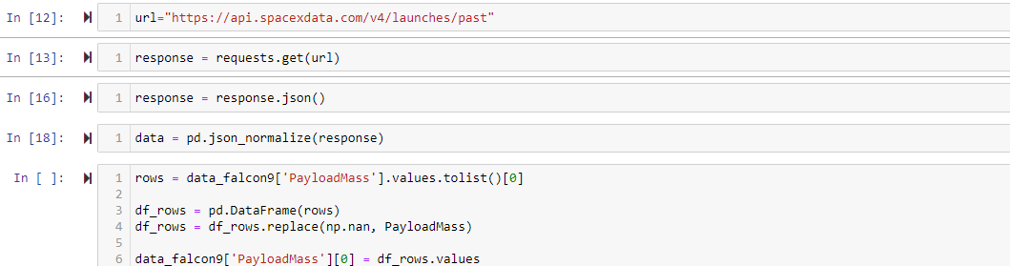
Data Collection – SpaceX API
We gathered data, cleaned the requested data, and performed some simple data wrangling and formatting using the get request to the SpaceX API.
https://github.com/mundasandeep5/datasciencecapstone/blob/main/Data%20Collection%20API.ipynb

Slide 9
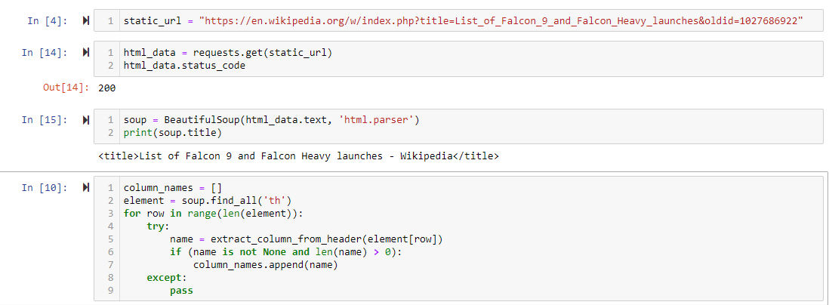
Data Collection - Scraping
Using BeautifulSoup, we performed web scraping on Falcon 9 launch records.
We parsed the table and created a pandas dataframe.
https://github.com/mundasandeep5/datasciencecapstone/blob/main/Data%20Collection%20with%20Web%20Scraping.ipynb

Slide 10
Data Wrangling
We identified the training labels by doing an exploratory data analysis.
We determined the quantity of launches at every location as well as the quantity and frequency of each orbit
Using the outcome column, we generated a landing page label and exported the CSV data.
https://github.com/mundasandeep5/datasciencecapstone/blob/main/Data%20Wrangling.ipynb

Slide 11
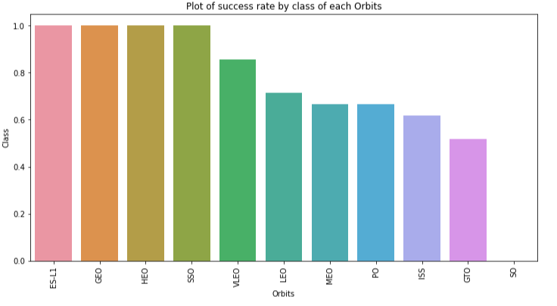
EDA with Data Visualization
Visualizing the relationships between flight number and launch site, payload and launch site, success rate of each orbit type, flight number and orbit type, and the annual trend of launch success allowed us to better understand the data.
https://github.com/mundasandeep5/datasciencecapstone/blob/main/EDA%20with%20Data%20Visualization.ipynb

Slide 12
EDA with SQL
We loaded the SpaceX dataset into a PostgreSQL database and used SQL and EDA to extract insights from the data.
For example, we created queries to find out:-
The names of the space mission's distinct launch locations.
The total mass of payload carried by NASA-launched boosters (CRS)- The mass of the payload that booster version F9 v1.1 typically carries
The total number of mission outcomes, both successful and unsuccessful;
The names of the launch sites and booster versions for the drone ship's unsuccessful landings
https://github.com/mundasandeep5/datasciencecapstone/blob/main/EDA%20with%20SQL.ipynb

Slide 13
Build an Interactive Map with Folium
On the folium map, we annotated every launch site and added map elements like circles, lines, and markers to indicate the success or failure of launches at each location.
Class 0 and 1 were given the feature launch outcomes (success or failure).that is, one for success and zero for failure.
We were able to determine which launch sites have a comparatively high success rate by using the color-labeled marker clusters.
We determined the separations between a launch site and its surrounding areas.
We responded to a few inquiries, such as:-
Are launch sites close to roadways, railroads, and beaches?
Do launch sites maintain a specific distance from urban areas?

Slide 14
Build a Dashboard with Plotly Dash
Using Plotly dash, we created an interactive dashboard.
We also plotted pie charts that displayed the total number of launches by specific sites and scatter graphs that illustrated the relationship between the payload mass (kg) and outcome for various booster versions.

Slide 15
Predictive Analysis (Classification)
Using pandas and numpy, we loaded the data, transformed it, and divided it into training and testing sets.
Using GridSearchCV, we constructed several machine learning models and adjusted various hyperparameters.
Our model's accuracy was measured, and it was enhanced through feature engineering and algorithm tuning.
The top-performing classification model was identified.
https://github.com/mundasandeep5/datasciencecapstone/blob/main/Machine%20Learning%20Prediction.ipynb

Slide 16
Results
Exploratory data analysis results
Interactive analytics demo in screenshots
Predictive analysis results

Slide 17

Section 2

Slide 18
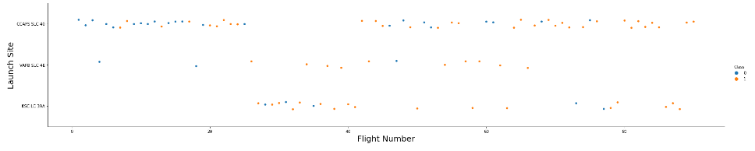
Flight Number vs. Launch Site
• Based on the plot, we discovered that a launch site's success rate increases with the number of flights conducted there.

Slide 19
Payload vs. Launch Site
Show a scatter plot of Payload vs. Launch Site
Show the screenshot of the scatter plot with explanations

Slide 20
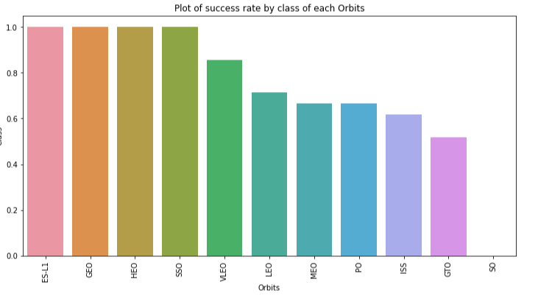
Success Rate vs. Orbit Type
We can see from the plot which ones had the highest success rate: ES-L1, GEO, HEO, SSO, and VLEO.

Slide 21
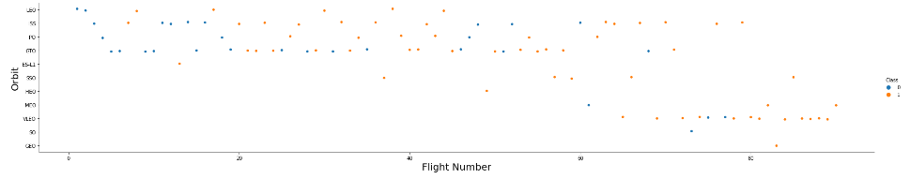
Flight Number vs. Orbit Type
The Flight Number vs. Orbit type plot is presented below. We note that while there is no correlation between flight number and orbit in the GTO orbit, success in the LEO orbit is correlated with the number of flights.

Slide 22
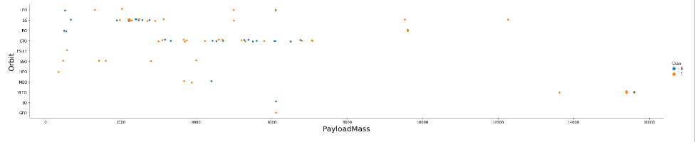
Payload vs. Orbit Type
We can observe that with heavy payloads, the successful landing are more for PO, LEO and ISS orbits.

Slide 23
Launch Success Yearly Trend
•

Slide 24
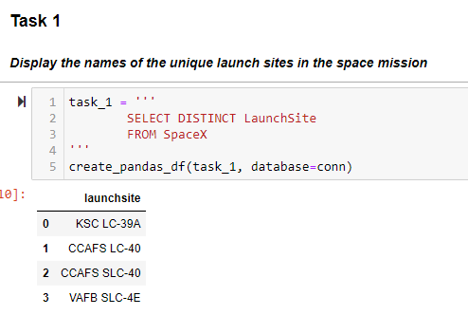
All Launch Site Names
We used the key word DISTINCT to show only unique launch sites from the SpaceX data.

Slide 25
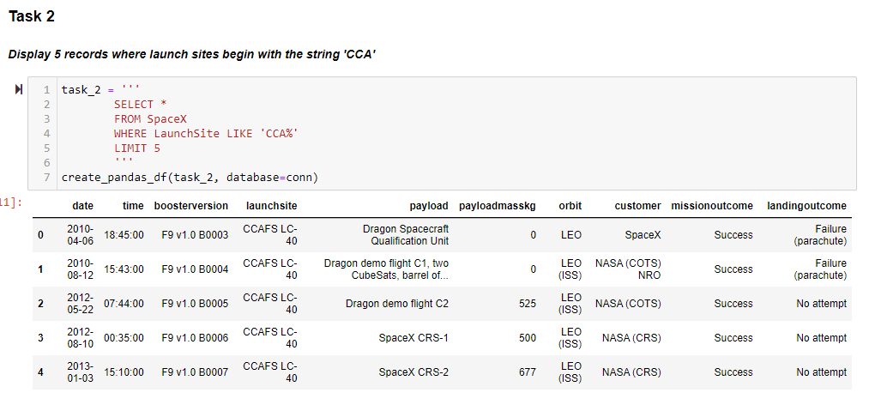
Launch Site Names Begin with 'CCA'
Using the aforementioned query, we were able to show five records whose launch sites start with {CCA}.

Slide 26
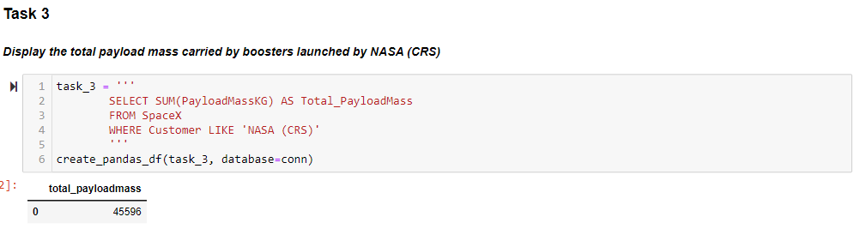
Total Payload Mass
Using the following query, we were able to calculate the total payload carried by NASA's boosters to be 45596.

Slide 27
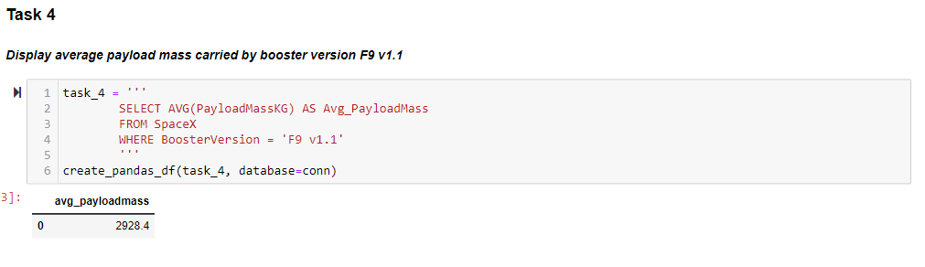
Average Payload Mass by F9 v1.1
We determined that the booster version F9 v1.1's average payload mass was 2928.4.

Slide 28
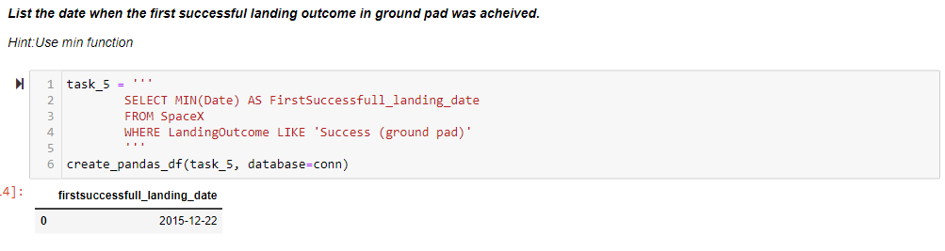
First Successful Ground Landing Date
We noted that the first successful landing on a ground pad occurred on December 22, 2015.

Slide 29
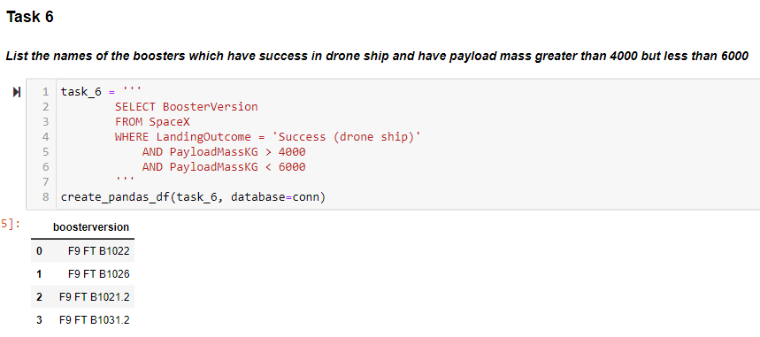
Successful Drone Ship Landing with Payload between 4000 and 6000
In order to identify boosters that have successfully landed on a drone ship, we used the WHERE clause to filter for those boosters. We then applied the AND condition to determine successful landings with payload masses greater than 4000 but less than 6000.

Slide 30
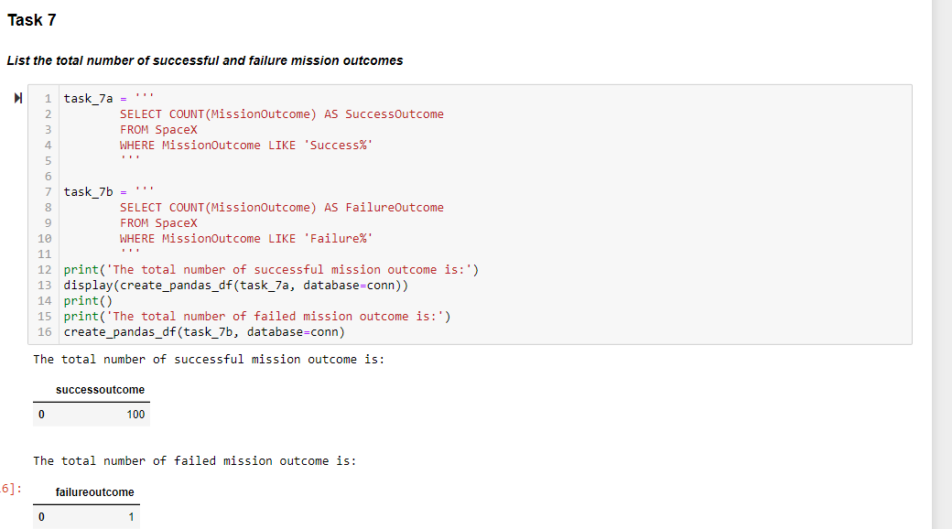
Total Number of Successful and Failure Mission Outcomes
• To filter for WHERE MissionOutcome was successful or unsuccessful, we used a wildcard like %.

Slide 31
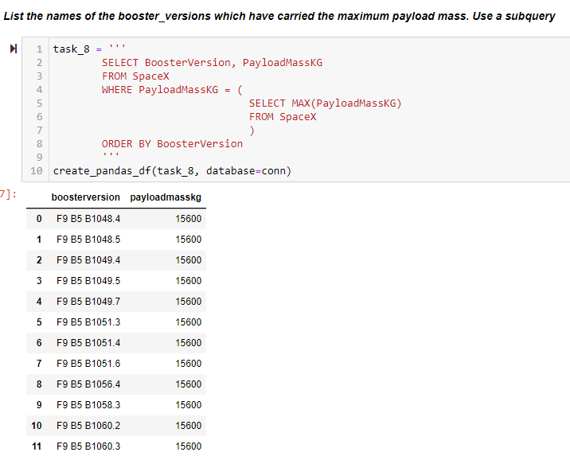
Boosters Carried Maximum Payload
Using a subquery in the WHERE clause and the MAX() function, we were able to identify the booster that had carried the maximum payload.

Slide 32
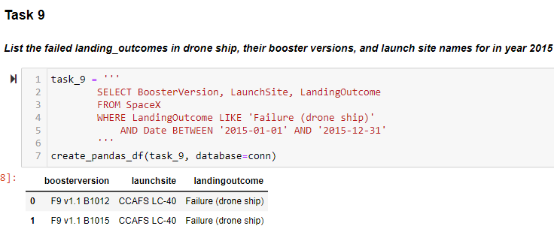
2015 Launch Records
• In order to filter for failed landing outcomes in drone ship, their booster versions, and launch site names for the year 2015, we combined the WHERE clause, LIKE, AND, and BETWEEN conditions.

Slide 33
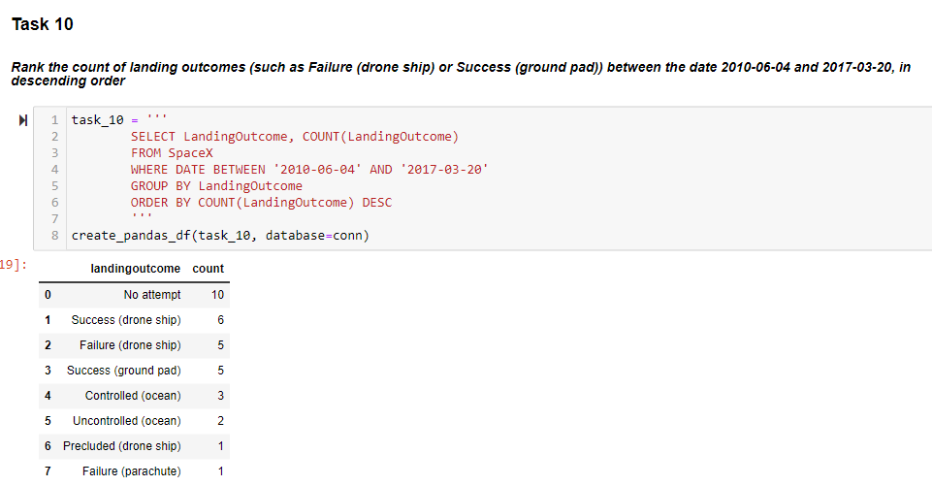
Rank Landing Outcomes Between 2010-06-04 and 2017-03-20
Using the WHERE clause, we filtered the data for landing outcomes BETWEEN 2010-06-04 and 2010-03-20. We also selected the landing outcomes and the COUNT of landing outcomes.• To group the landing outcomes, we used the GROUP BY clause. To order the grouped landing outcomes in descending order, we used the ORDER BY clause.

Slide 34

Section 3

Slide 35
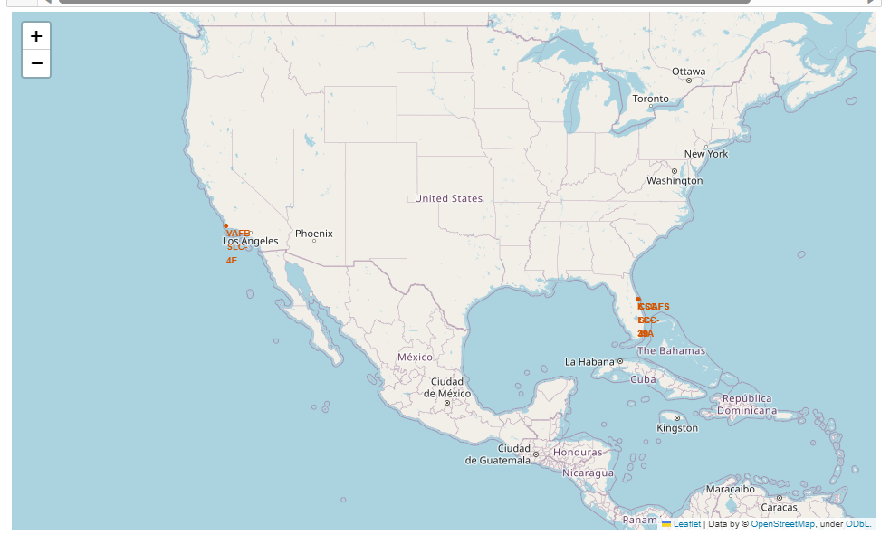
All launch sites global map markers

Slide 36
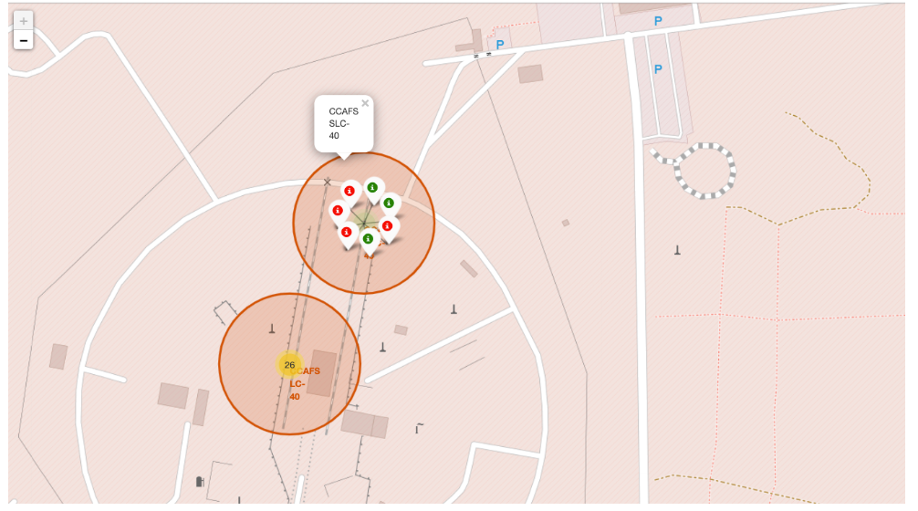
Markers showing launch sites with color labels

Slide 37
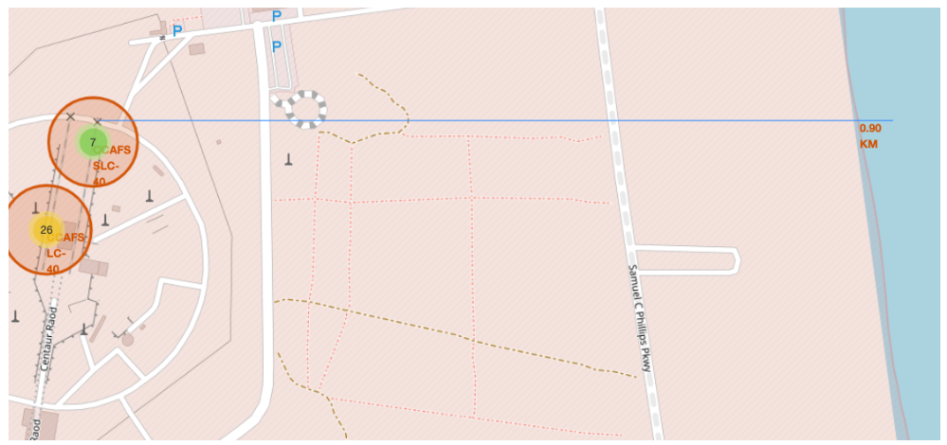
Launch Site distance to landmarks

Slide 38

Section 4

Slide 39
Pie chart showing the success percentage achieved by each launch site
Replace <Dashboard screenshot 1> title with an appropriate title
Show the screenshot of launch success count for all sites, in a piechart
Explain the important elements and findings on the screenshot

Slide 40
<Dashboard Screenshot 2>
Replace <Dashboard screenshot 2> title with an appropriate title
Show the screenshot of the piechart for the launch site with highest launch success ratio
Explain the important elements and findings on the screenshot

Slide 41
<Dashboard Screenshot 3>
Replace <Dashboard screenshot 3> title with an appropriate title
Show screenshots of Payload vs. Launch Outcome scatter plot for all sites, with different payload selected in the range slider
Explain the important elements and findings on the screenshot, such as which payload range or booster version have the largest success rate, etc.

Slide 42

Section 5

Slide 43
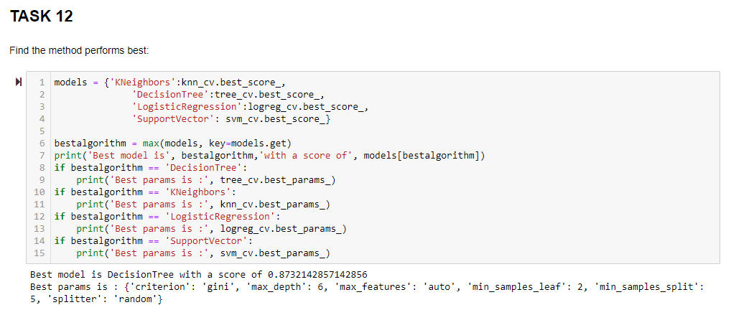
Classification Accuracy
• The model with the best classification accuracy is the decision tree classifier.

Slide 44
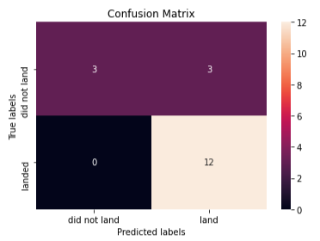
Confusion Matrix
• The decision tree classifier's confusion matrix demonstrates the classifier's ability to discriminate between the various classes. False positives are the main issue .i.e., the classifier marks an unsuccessful landing as successful.

Slide 45
Conclusions
We can draw the following conclusions:
A launch site's success rate increases with the number of flights conducted there.
• The launch success rate increased from 2013 to 2020.
The orbits with the highest success rate were ES-L1, GEO, HEO, SSO, and VLEO.Out of all the sites, KSC LC-39A had the most successful launches.
For this task, the optimal machine learning algorithm is the decision tree classifier.

Slide 46


